Slide 1
Restorative Practices in a EI High School
Mike Croy, Principal
Neil Reid High School
IIRP World Conference

Slide 4
What are the 3 main purposes of Restorative Practices?
Building Managing Repairing
Relationships!!!

Slide 5
Purpose of Session
Learn the 3 main reasons Restorative Practices exist
Learn the components that make up the Restorative Practices continuum
Learn how the Restorative Practices continuum is used in a Emotionally Impaired Center Based High School

Slide 6
Why Restorative Practices?

Slide 7
Why Restorative Practices?
Restorative practices (RP) are a positive alternative to zero tolerance policies.
Zero tolerance policy: application of predetermined consequences, most often severe and punitive in nature, that are applied regardless of the behavior, circumstances, or context.

Slide 8
Suspensions vs. Graduations
Approximately, 3.45 million students are suspended In 2017 from secondary schools. Note that students who are not white and those who receive special education services are more likely to be suspended.
Slightly more than 3.6 million students graduated in 2017

Slide 9
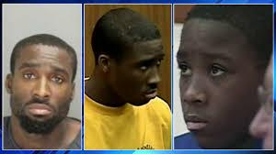
Prison
The United States has the highest per capita incarceration rate of any large nation in the world.

Slide 10
There is NO RESEARCH to show that ZERO TOLERANCE actually discourages students from engaging in acts of violence.
What Zero Tolerance does do is create disengagement for students. It shows them that they are not valued.

Slide 11
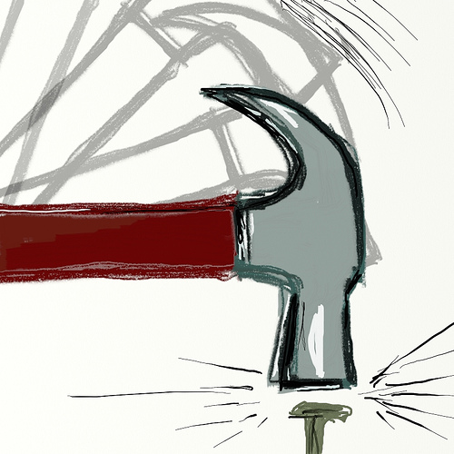
Need More of
Need Less of

Slide 12
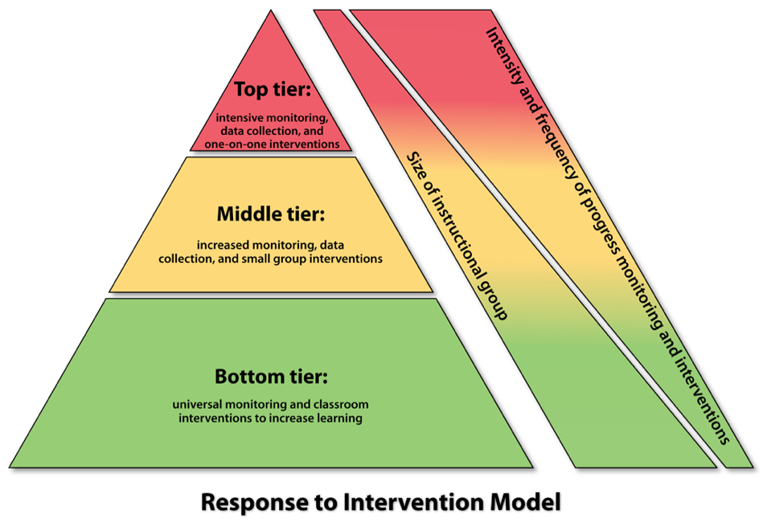
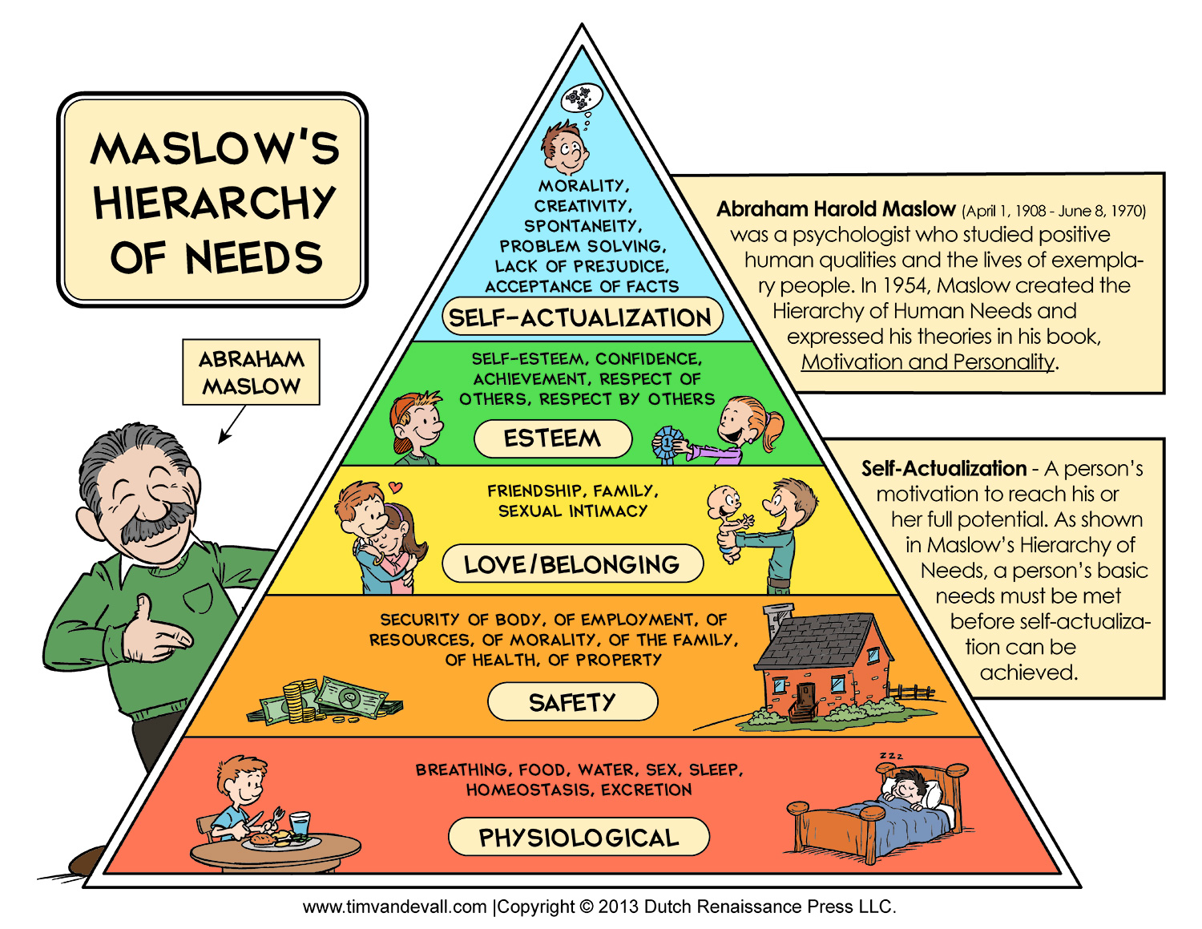
Positive Behavior Interventions and Supports (PBIS)

Slide 14
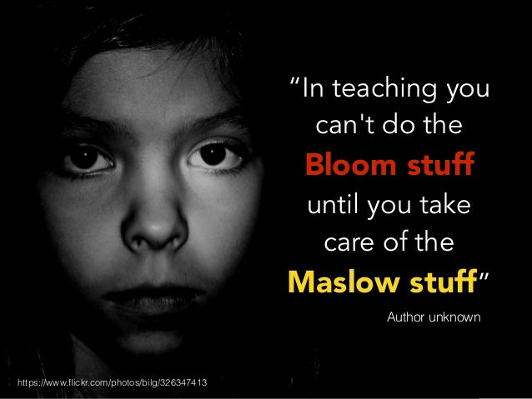

Slide 15
What is the Purpose of RP?
Build Manage Repair
Relationships!!!

Slide 16
The fundamental hypothesis of restorative practices is that human beings are happier, more cooperative, and productive, and more likely to make positive changes in their behaviors when those in positions of authority do things WITH them, rather than TO them or FOR them.

Slide 17
Social Discipline Window

Slide 18
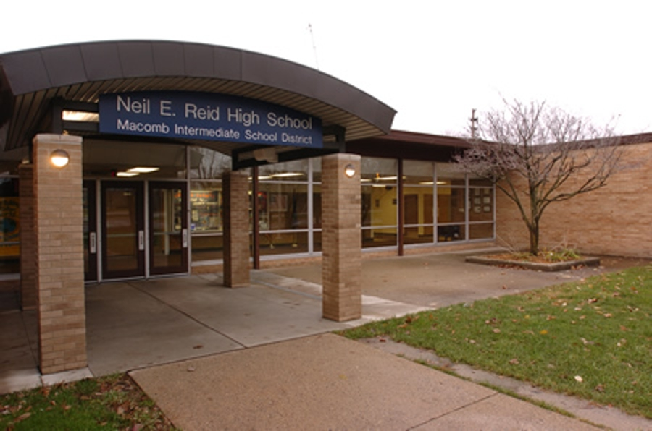
Neil Reid High School
Neil Reid High School

Slide 19
MI School Data
According to MI School Data, approximately 11,333 (5.5 %) students carry the certification of Emotionally Impaired in the state of Michigan. In Macomb County, of the 18,912 special education students, there are approximately 899 students (4.8%) certified as Emotionally Impaired. Currently there are 108 students enrolled at Neil Reid High School (12% ) of the county’s EI population.

Slide 20
Neil Reid High School
Services all 21 local school districts in Macomb County
Max enrollment: 120 (top 12% of EI Students in Macomb County)
1 Principal
1 Program Associate
1 Teacher Consultant
1 School Social Worker
1 School Psychologist
13 Teachers
14 Paraprofessionals
2 Secretaries

Slide 21
Neil Reid High School
Students do not graduate from Neil Reid. They graduate from their local.
Schedule is similar to a local school district (7 periods)
Over 90% of students are working on their high school diploma.
Students/families work with MRS to begin CBA (Community Based Assessments) as soon as they turn 16
Therapy Dog Program
Monthly Gleaners Mobile Food Pantry
Yoga/Art/Running Club as supplemental activities

Slide 22
2018/2019 Enrollment
9th grade – 28 students
10th grade – 35 students
11th grade - 20 students
12th grade – 25 students
Enrollment: 108
83% male/17 % female

Slide 23
2018/2019 Demographics
1 % American Indian/Native American
1 % Asian American
1% Multi Racial
23% African American
74% White

Slide 24
The Journey

Slide 25
Neil Reid High School
2015-2016
Started with a book study amongst admin group (Principal, Program Associate, Teacher Consultant, School Social Worker, School Psychologist)
- ½ Professional Development by trained IIRP facilitator in second semester of the year.
Book study with teachers: Restorative Practices Handbook
Began using Restorative Circles in some situations
School wide 7 Habits of Highly Effective Teens

Slide 26
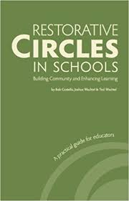
Neil Reid High School
2016-2017
Book study with teachers: Restorative Circles in Schools
PD with all staff in ACES (Adverse Childhood Experiences)
Paraprofessionals did a modified book study with RP Handbook
Suggested to teachers that they incorporate Classroom Circles as part of daily routine in first semester
Beginning second semester, teachers were expected to hold AM/PM Circles with homeroom students

Slide 27
Restorative Practices Continuum

Slide 28
Classroom Circles
Circles are one of the most distinctive and flexible forms of RP
Circles are very effective as a proactive process for building social capital and creating class norms
Most common way to do a circle is to arrange students chairs in a circle, ask a question, and have students respond in turn going around the circle.
It helps to have a “talking piece”
A benefit of the “go around” strategy is that it allows quieter students the opportunity to be heard with out having to compete with more assertive students

Slide 29
Circle Expectations Examples:

Slide 30
Circle Expectations Examples:

Slide 31
Restorative Conferences

Slide 32
Neil Reid High School
2016-2017
- began collecting data as to how many times RP was used with students.
- 1st Quarter – 35 write-ups indicated RP used
- 2nd Quarter – 16 write-ups indicated RP used
- 3rd Quarter – 28 write-ups indicated RP used
- 4th Quarter – 16 write-ups indicated RP used
* Before 17/18 school year – several staff attended a RP seminar and I attended a 4 day training through Michigan Restorative Practices Trainers and Consultants. I can facilitate a ½ day RP session for staff.

Slide 33
2017 – 2018 School Year
Effective August 1, 2017, there were a series of revisions to Michigan’s Zero Tolerance Laws. The new laws require consideration of seven factors in EVERY case of suspension/expulsion except for FIREARMS
The 7 Factors
Age
Disciplinary History
Disability
Seriousness of behavior
Whether behavior posed safety risk
Was the student a danger to self?
Was the student a danger to others?

Slide 34
7 Factors (continued)
6. Use of Restorative Practices MCL 380.1310c – “practices that emphasize repairing the harm to the victim and the school caused by a pupil’s misconduct.’
They may include:
- Victim/offender conferences
- Opportunity for the offender to accept responsibility and “repair the harm”
They may require the offender to:
- Apologize
- Participate in community service, restoration or counseling
- Pay restitution

Slide 35
7 Factors (continued)
7. RESTORATIVE PRACTICES should be the first consideration when dealing with:
- Bullying
- Verbal and Physical Conflicts
- Theft
- Property Damage
- Class Disruption
- Harassment and Cyberbullying
- Interpersonal Conflicts

Slide 36
2017 – 2018 School Year
AM – Classroom Circles
PM – Classroom Circles
Look at disaggregating the RP Data into one of the following categories:
- Bullying
- Verbal and Physical Conflicts
- Theft
- Property Damage
- Class Disruption
- Harassment and Cyberbullying
- Interpersonal Conflicts

Slide 37
2017 – 2018 School Year
In addition, staff started using a new Student Social/Emotional Learning Survey to help write meaningful IEP Goals/Objectives.
* Self Awareness
* Self Management
* Social Awareness
* Relationship Skills
* Responsible Decision Making

Slide 38
Suspensions are down!!!
Suspension Data
School Year | # of Days Suspended | # of Students Involved
2015-2016 | 168 days | 49 students
2016-2017 | 119 days | 36 students
2017-2018 | 75 days | 30 students

Slide 39
2017/2018 Restorative Practices Data:
1st Quarter – 16 Restorative Practice Conferences
2nd Quarter – 7 Restorative Practice Conferences
3rd Quarter – 10 Restorative Practice Conferences
4th Quarter - 6 Restorative Practice Conferences
Data indicates that Restorative Practices have been primarily used for:
Interpersonal Conflict
Verbal Conflict
Class Disruption

Slide 40
2018-2019 Targets
Continue with AM/PM Homeroom Circles for students.
Utilize the data from 2017/2018 indicating that Restorative Practices were used primarily for verbal conflict, interpersonal conflict, and class disruptions to look at building lessons to practice/model/teach students.
Disaggregate the data to dig deeper (potential areas: grade level/male/female)
Keep working the process

Slide 41
2018/2019 Data (9/6- 10/12)
24 Restorative Practices
Total Suspensions: 2 (state reportable) – Drugs
Classroom Circles: 52 days, 624 circles

Slide 42
2018/2019 School Year Data (9/6- 10/12)

Slide 43
2018/2019 Data (9/6- 10/12)

Slide 44
What if I Get It……

Slide 45
But What if I Get It……

Slide 47
In the end, what matters is……
Building Managing Repairing
Relationships!!!

Slide 48
Questions/Comments?
mcroy@misd.net
734.502.6368

