Slide 1
Lessons from Teaching: How High School Student Restorative Practitioners Impact and Inspire
Presenters: Diane Back, Rollie Caswell, Omar Hassain, Amy McLoughlin, Arik Rorie, Beth Sherman, Zain Smith
October 25, 2018

Slide 2
IIRP Engage Session Objectives
Participants will be able to articulate the value of student led restorative practices.
Participants will be able to identify needs around multidisciplinary, participatory training on restorative practices in higher education settings.

Slide 3
Agenda
Context for the University of Michigan course
Skysquad background and origin at Skyline High School
Skysquad presenters / Q & A
Lessons learned from the University of Michigan class
Discussion / Impact / Q & A

Slide 4
Context
Graduate level 1 credit course “Restorative Practices in Schools and Communities”
Multidisciplinary participating graduate students in social work and education, and practicing social workers earning continuing education credits. Goals:
  Present both responsive and proactive restorative practices across multiple settings (communities, schools, juvenile justice, and organizations).
  Validate the significant importance that self-advocacy and social connections have upon youth in school and community settings.
  Inspire participants to learn more about restorative practices and advocate for implementation of restorative practices in their work.
Notes:
Spring 2014 – Diane and Beth attend peacemaking circles
SY 2014-2015 – Diane consults with area school district regarding disproportionality / restorative work promoting youth voice (students involved with all teacher trainings)
Fall 2015 – course proposal to UM/development and why this course was created.
Spring 2016 – 1 credit UM SSW course launched
• importance of youth/student voice to be incorporated into school curriculum – restorative practices natural evolution of promoting inclusion & choice both educationally and organizationally

Slide 5
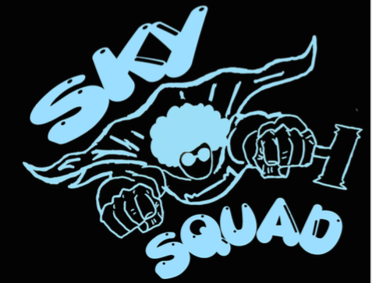

Slide 6
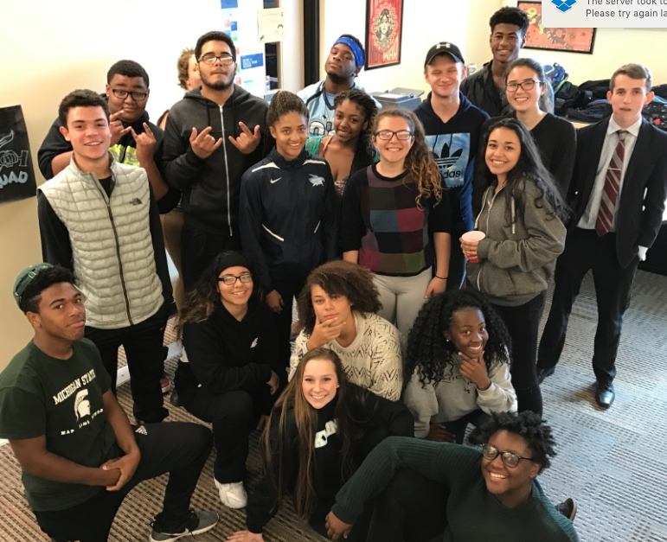

Slide 8
Our Herstory/History
In the fall of 2014 we brainstormed ideas for a conflict mediation program.
After attending a Restorative Practices symposium at the University of Michigan, we wrote a grant to fund training from the Dispute Resolution Center.
16 students were chosen by teachers and administration along with 8 adults to attend the 2 day intensive training.

Slide 9
After the training
The students and Amy met twice a week for a month to develop a program that would prove authentic.
We practiced peacemaking in and out of circles.
We discussed what peacemaking could look like in our school and the ramifications for choosing peace in times of struggle.
We worked with administration to talk about the relevancy of restorative practices in our discipline structure. We spoke at staff meetings to help teachers understand.

Slide 10
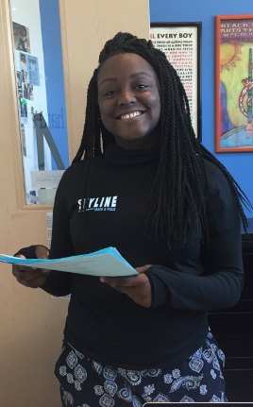
5 years later
We have conducted over 260 circles with a 96% resolution rate
Established a student only circle resolution process
Secured an office and class credit for students to staff the office
Coordinated a reduced suspension plan with administration
Implemented a 9th grade mentoring program
Created a ½ time counselor FTE

Slide 11
How did all that happen?
Consistent and timely training from community experts and agencies.
Communication of purpose-daily. 1. A belief that we do this work because we have to, it is within us to lead and inspire others to be their best selves. 2. The school to prison pipeline is real, and we will not let bad choices define our community member/our tribe.
Establishing “perks”. MOTIVATION
Administrative support and trust.
Students attending and presenting at symposiums and peacemaking workshops.

Slide 12
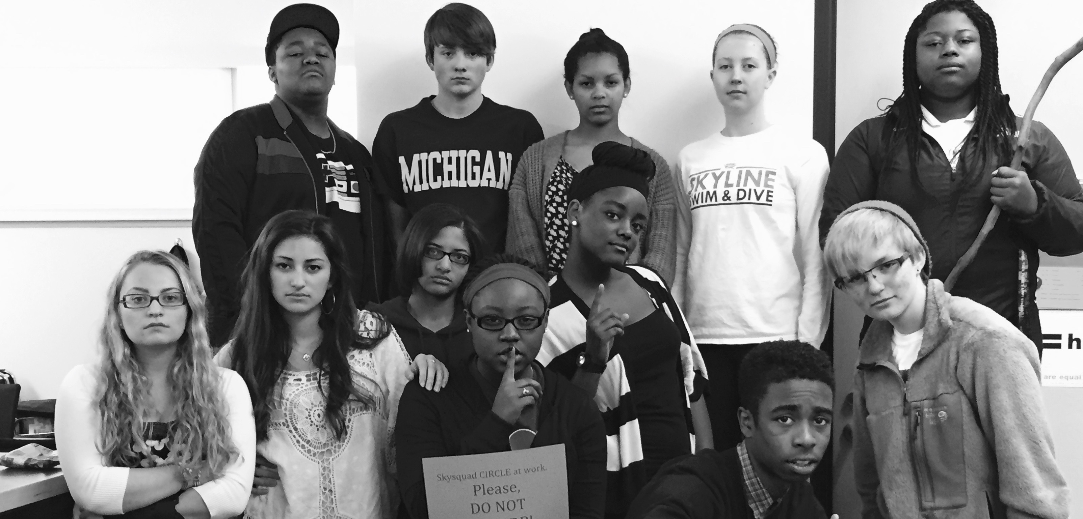
Who is skysquad?
practitioners must represent all aspects of our school community-chosen and interviewed by current sky squad members
must demonstrate a passion to think differently and critically
embrace their role as change agents and peacekeepers
brave and courageous enough to be vulnerable and empathetic

Slide 13
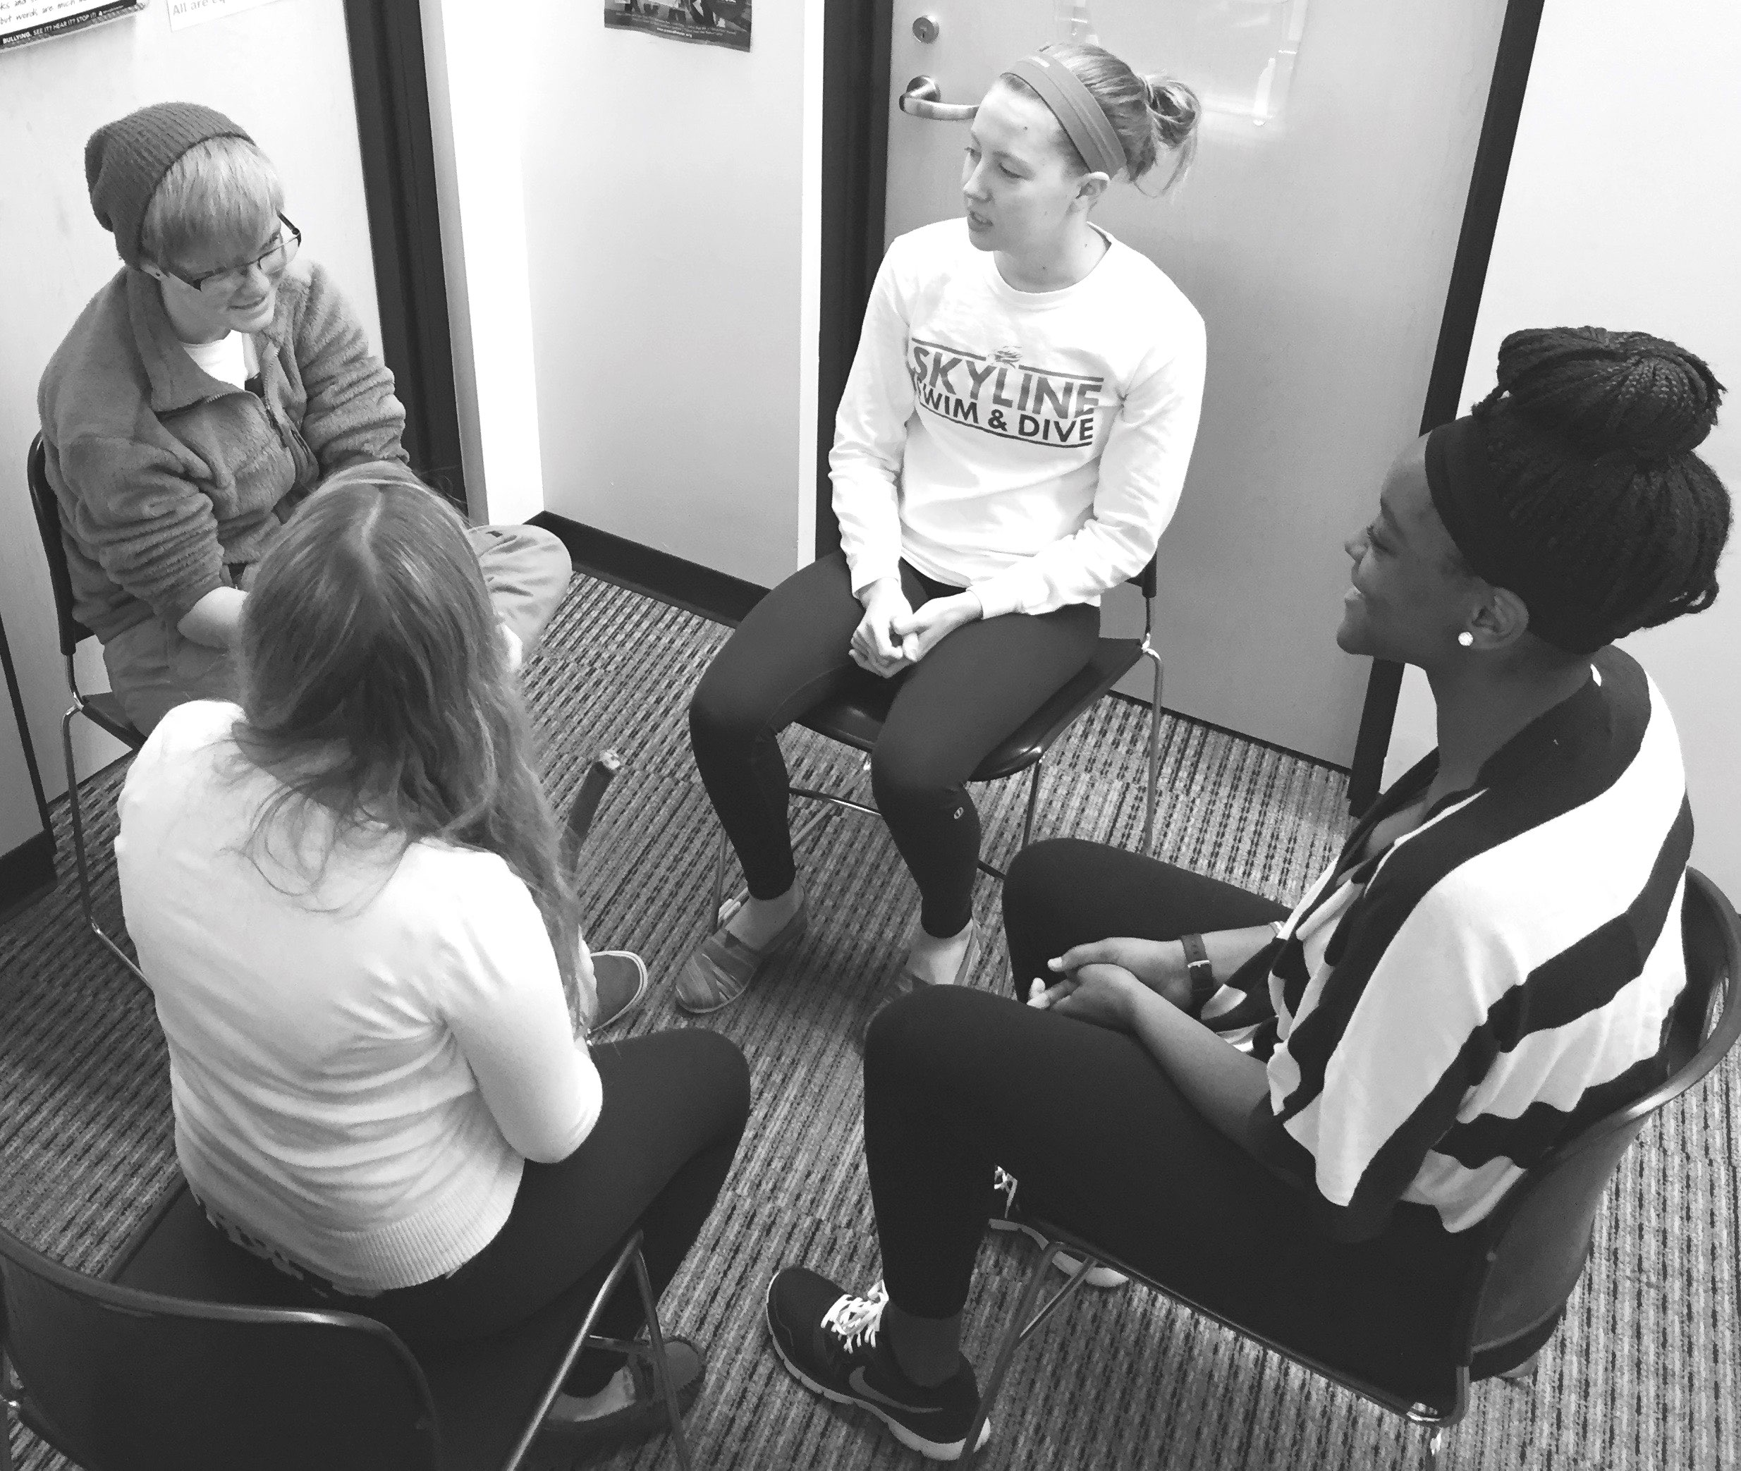
The Process
Students in conflict can refer themselves or be referred by friends, teachers or administrators.
All students returning from suspension are asked to participate in a re-entry circle.
Skysquad students set-up the room and escort participants from their class.
Participants first speak with Ms. McLoughlin to make sure their participation is voluntary and constructive.
Immediately following the circle, practitioners de-brief and reflect with Ms. McLoughlin. The following day or week, circle participants are asked to answer a 4 question survey and to review the resolution. On-going check-ins are determined as needed.

Slide 14
Circling up

Slide 15
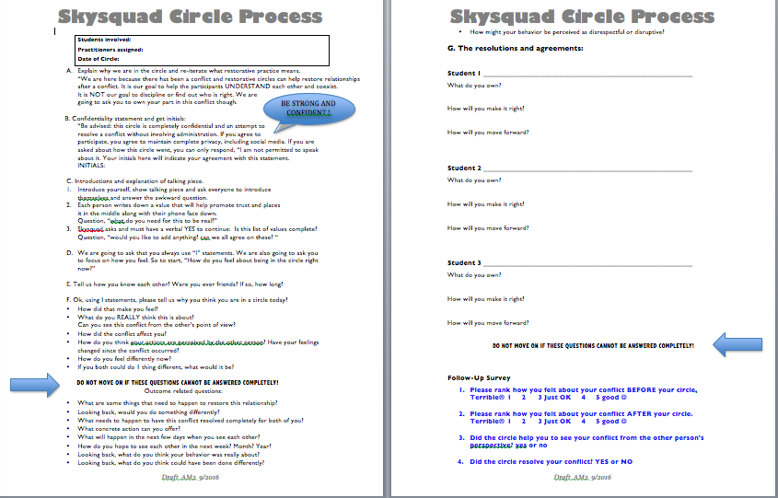

Slide 16
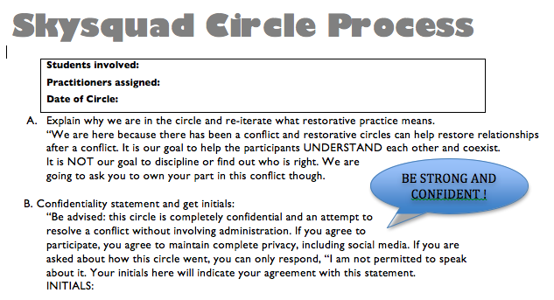

Slide 17
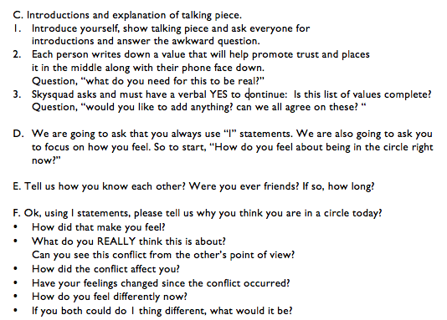

Slide 18
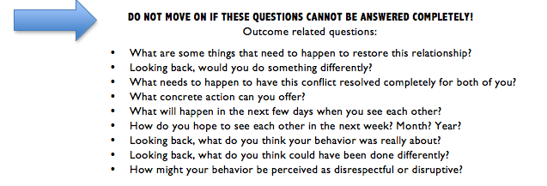

Slide 19
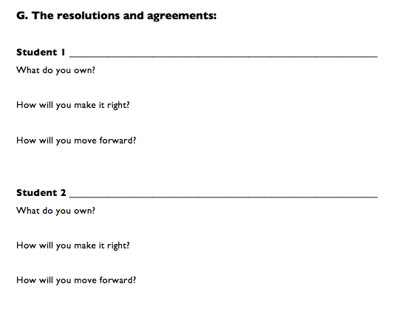

Slide 20
Predominate Circle topics
Friendship misunderstandings
Classroom tensions
Racism, sexism, homophobia
MISCOMMUNICATION

Slide 21
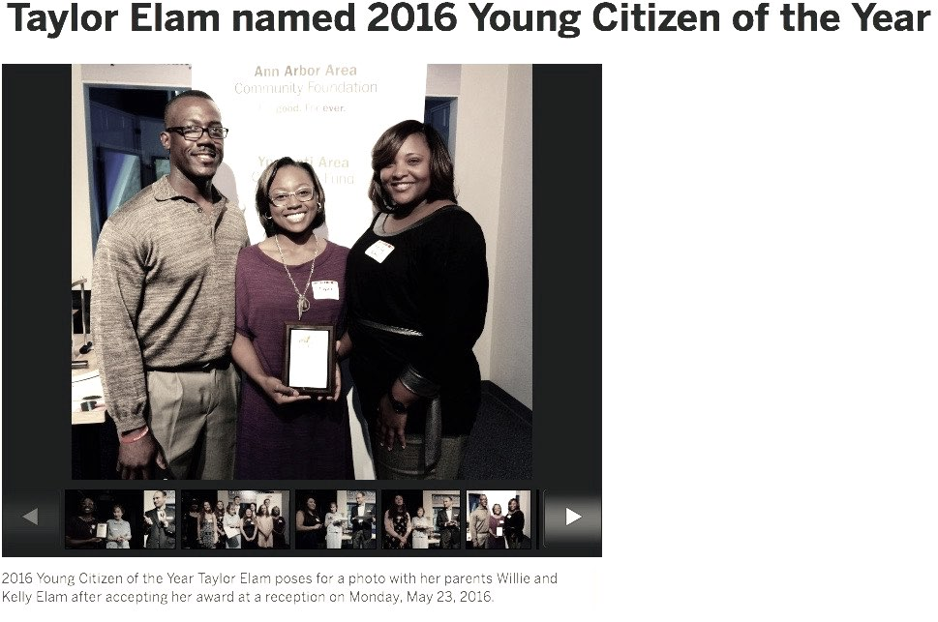
Why we do this work and how the work changes everything.

Slide 22

MANIFESTO OF THE BRAVE
Brene’ Brown
There is no greater threat to the critics and cynics and fearmongers
Than those of us who are willing to fall
Because we have learned how to rise.
With skinned knees and bruised hearts;
We choose owning our stories of struggle,
Over hiding, over hustling, over pretending.
When we deny our stories, they define us.
When we run from struggle, we are never free.
So we turn toward truth and look it in the eye.
We will not be characters in our stories.
Not villains, not victims, not even heroes.
We are the authors of our lives. We write our own daring endings.
We craft love from heartbreak,
Compassion from shame,
Grace from disappointment,
Courage from failure.
Showing up is our power.
Story is our way home.
Truth is our song.
We are the brave and courageous.
We are rising strong

Slide 23

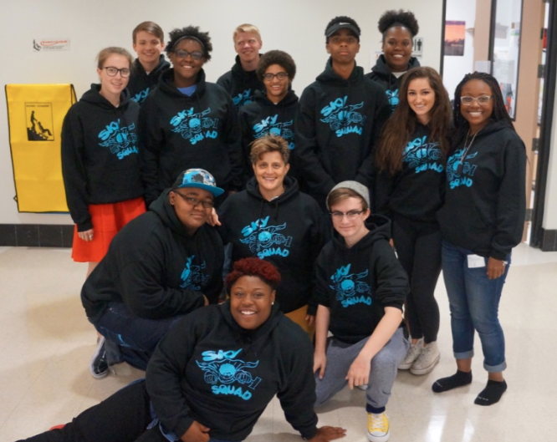
Questions and gratitude.

Slide 24
Lessons Learned
Emerging themes include:
  Value of restorative practices across multiple settings.
  Inspired by youth practitioners.
  Value of interdisciplinary training at pre-service level.
  Increased desire for additional training and restorative practices implementation.
  Empowered participants to take positive action.
Notes:
* It was wonderful and inspiring to hear both from youth and adult experts, and it helped to frame how these practices can fit into various areas of work.
*This should be a 3 credit course.
*The class increased my interest in restorative practices. I plan to seek out more training.
*I called my Mom, who is a teacher, and told her about the incredibly confident, inspiring, and peacemaking high school students who taught me today.
*Seeing what the counselor did at her school inspired me to try to make changes in my school. Sometimes things can feel so big, overwhelming, and broken but seeing how positive change can happen really encouraged me.

Slide 25
Discussion
What are some takeaways related to the possibilities for multidisciplinary, participatory training on restorative practices?
How might this model of engagement impact your work?

Slide 26
Thank you!
Diane Back, MSW, LMSW, backd@wwcsd.net
Amy McLoughlin, mclough@aaps.k12.mi.us
Beth Sherman MSW, LMSW, shermanb@umich.edu

