Slide 1
A Restorative Approach to Diversity and Inclusion
MALLORY MARTIN-FERGUSON, M.Ed
ASSOCIATE DIRECTOR OF HOUSING
STUDENT CONDUCT AND CONFLICT RESOLUTION
SHIRA COVINGTON, M.S.
ASSISTANT DIRECTOR OF DIVERSITY AND INCLUSION
Notes:
Shira starts
50 minutes
10:50AM start time

Slide 2
Session Overview and Objectives
Share concepts and framing of Restorative Practices
Discuss how this framework fits into our understanding of Diversity and Inclusion.
Our perspective on Restorative work is that it is both a tool to resolving conflict in a community and developing healthy relationships.
Please feel free to stop us and ask questions!
Notes:
Shira

Slide 3
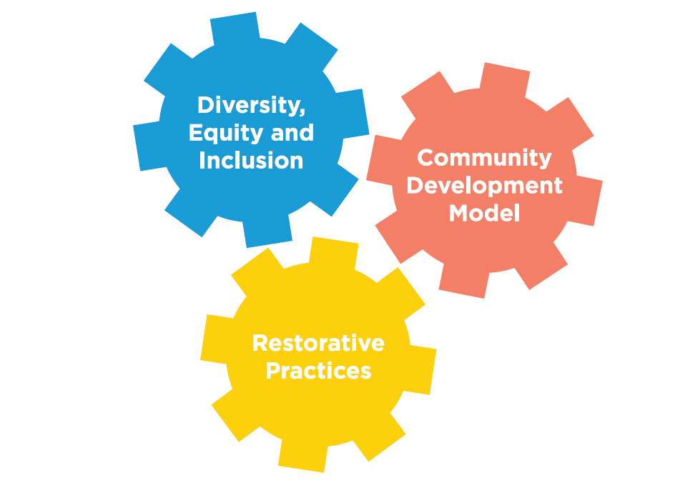
Community Values
Notes:
Shira
Specific to Residence Education. Talk about overall Housing Values and how we share this with staff.

Slide 4
Core Concepts of CDM
Our Community Development Model (CDM) is our primary tool used by professional and student staff to co-create positive, inclusive communities. CDM is an assessment based model guided by intentional community supervision, collaboration and investment.
The tenets of the CDM are:
1. Get to know every resident very well
2. Assist residents in getting to know each other
3. Assess the needs of the community
4. Develop activities to address the needs that have been identified
5. Assist residents in taking/sharing ownership for their community
Notes:
Mallory
New focus on intentional interactions this year.

Slide 5
Core Concepts of D, E and I
Diversity, Equity and Inclusion is a way to promote our values through social justice education and community engagement. We strive to recognize the global society and diverse communities that our residents make up, both nationally and internationally and by doing that, create inclusive communities.
Notes:
Shira
Language change to align with how nationally institution of higher education discuss, align with our university presidents DEI strategic plan, and to address all parts of the conversation.

Slide 6
Core Concepts of Restorative Practices
Restorative Practices is a philosophy and set of practices that are based in participatory learning and decision making.
Proactive approach to relationship and community building
Restorative Justice is a formal response that works to address how people may have been harmed, and involves impacted parties to have an active role
Parties work to build and regain trust in the community
Notes:
Mallory

Slide 7
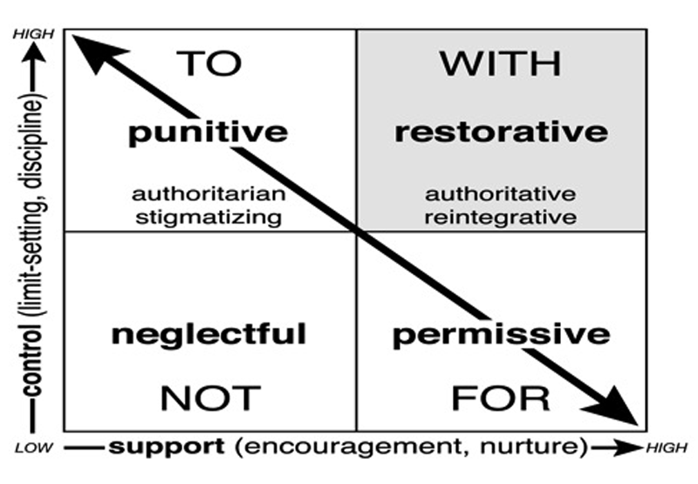
Social Discipline Window
Wachtel, T. (1999). Restorative justice in everyday life: Beyond the formal ritual. Reshaping Australian Institutions Conference: Restorative Justice and Civil Society, Canberra, Australia.
Notes:
Mallory
“Human beings are happier, more cooperative and productive, and more likely to make positive changes in their behavior when those in positions of authority do things with them, rather than to them or for them. (Wachtel, 2016)”
Recognize there may be differences based on leadership and response role.

Slide 8
Framework at Michigan
Used as model within Housing and the Office of Student Conflict Resolution
Floor meetings within residential communities
Community Circle process
Written impact statement
Impacted party check in
Social Justice and Restorative Justice competencies created and shared with staff
DEI programming model
Notes:
Mallory

Slide 9
Restorative Questions
In meetings, students are asked to respond to the following questions:
What level of involvement or responsibility might you have in this incident?
Who may have been harmed in this incident and in what ways?
What can be done to address and repair the harm that may have been caused in the community?
Notes:
Mallory

Slide 10
Questions to Ask Yourself
What’s the harm?
Who has been harmed?
Is/can identity be part of the conflict?
How do you approach the conversation?
How do I keep identity and restorative justice in the conversation?
Suggestions on how the harm can be repaired?
Notes:
Mallory

Slide 11
Examples
Student Performance Management
Community Circles
“For students who don't fully understand their actions and what consequences their actions have, the community circle program provides a much needed 'wake-up call'. Were it not for this program, I feel people would simply harbor a grudge rather than learning from their mistakes. Personally, I feel that this program has given me the opportunity to really understand the guidelines we are expected to follow, and the entire process of ensuring the community's safety."
Notes:
Role, Responsibility and Respect
Mallory and Shira

Slide 12
RJ Connection to Inclusion Work
Connection to Building Community:
SJ and RJ are both contribute to building happy and healthy communities; both discuss your role in a community.
Identity matters: in both building relationships, your role in a community, and in conflict.
We use RP, not as a process, but as a framework for how to communicate across difference and how to build trust when harm has been caused.
Bystander Intervention: everyone has a role in the community to intervene in harmful behavior
Notes:
Shira

Slide 13
RJ Connection to Inclusion Work
Use this framework in both prevention and response lens.
The prevention work looks at how this impacts a student's experience on campus and therefore their success within a community.
Building this type of community requires:
Learning role within community
Responsibility and accountability
Ownership over actions
Ability to make mistakes
Notes:
Shira

Slide 14
RJ Connection to Inclusion Work
Use of this in response to incidents:
Bias Incidents
Inclusive Community Concerns
Microaggressions
Overt Acts
Acknowledging Impact of Campus Climate
Notes:
Shira
Response

Slide 15
RJ Connection to Inclusion Work
Response Framework Allows For:
Education, growth, and awareness
Introduction of the concept of multiple truths
Focuses on repairing the harm caused
(including the harm to the respondent)
Addresses perceptions by those involved
Respondent to take ownership
Agency of the individual impacted
Notes:
Shira
Example: Oxford social media incident

Slide 16
Freedom of Speech
We work hard to respect freedom of speech among our students.
However, with freedom of speech comes responsibility.
Having the freedom to speech does not mean we don’t still impact someone with our words or lack of words.
Educational conversations focus on:
Impact instead of whether they should or should not have said something.
The choice they have in how their words, actions, or inactions will impact someone
Notes:
Mallory?
National climate conversation

Slide 17
Managing Resistance
Focus is on:
Role in community
Educational conversation, goal is not to get someone in trouble
Creating a space for dialogue and engagement
Example:
Recent e-mails from white students about campus climate
Notes:
EQ e-mail - Steve conversation
Students of color who believe they don’t hold privilege
Mallory?

Slide 18
Questions
Thank you!
Shira Covington: svduncan@umich.edu
Mallory Martin-Ferguson: mallomar@umich.edu
Notes:
Both

Slide 19
Social and Restorative Justice Competencies
Currently, we have competencies for professional staff:
Each component has an overall competency
Position specific individual competencies for year one, year two, and year three and beyond.
Each year has specific competencies under:
knowledge, skills, attitudes, and actions that are expected.
E-mail for full list of competencies, examples on next page
Notes:
Mallory

Slide 20
Examples of Competencies - Inclusion
Overall core competencies for diversity and inclusion:
Demonstrates inclusivity with professional staff, student staff, and residents. Inclusivity means respecting and affirming the equal human worth of every individual and of all distinctive groups of people.
Strives to learn and grow in understanding the impact of identity and culture has on our daily work.
Incorporates social justice philosophies in supervision, collaboration, and interactions with students and colleagues.
Displays comfort in discussing impact of social identities and culture on communication, crisis, conflict resolution, and community.
Assess own privileges, values, biases, and assumptions related to identity.
Notes:
Mallory

Slide 21
Examples of Competencies -
Restorative Justice
Overall Competency Framework for Restorative Justice (RJ):
RJ seeks to rebuild trust in the community and amongst people after an incident has occurred; staff should be able to articulate RJ values and their importance in our communities for students, faculty and staff on campus.
Staff should be able to recognize and name: Harm in the community; Impact of the harm in the community; How a person is involved in creating and restoring the harm.
RJ is utilized as a way to build community in the residence halls. By educating residents on the values and expectations of living in a community work can be done to build and repair trust while maintaining accountability in and expectations of the Community Living Standards as outlined in the CLAM.
RJ frames the conduct process and conversations had with residents as educational and transformative, not punitive. Wherever possible a restorative measure should be the outcome of conduct conversations.
Notes:
Mallory

Slide 22
Freedom of Speech Continued
Train our student staff on respecting freedom of speech and how to acknowledge and affirm the harm someone may be experiencing.
In our training we discuss:
Expectations of staff in respecting of freedom of speech
Reporting bias incidents and addressing the harm
And the opportunities we can create to address speech when it is not in align with our values.
Notes:
Amanda

Slide 23
Privacy
We honor all FERPA laws and keep individuals and their identities private.
Residents have to self select in a conversation with impacted parties
Use shuttle diplomacy (with professional staff) between students as needed.
Notes:
Mallory

