Slide 1
Scott Milner Regional Executive Director of Education
System-Wide Change
Building Strategy Networks
to Grow Restorative Practices

Slide 2
Learning Outcomes
Brief background of my restorative journey.
Share the opportunity a change in leadership can provide.
Describe some of the challenges and opportunities of a new way of thinking about change management.
Notes:
Less about the rationale for restorative approach rather a new way of looking at change management.

Slide 3
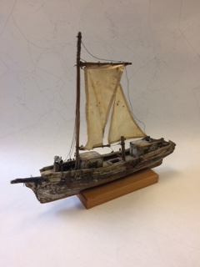
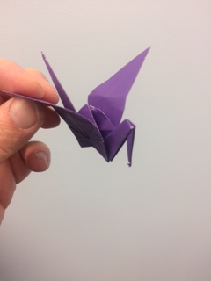
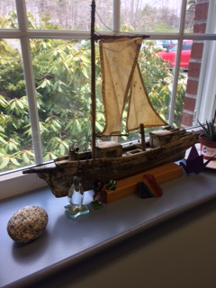
MY RESTORATIVE JOURNEY Influential Experiences

Slide 4
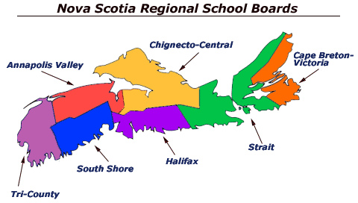
Notes:
For those of you who may not know, Nova Scotia is located on the east coast of Canada. It is a small province with a population of approximately one million people. Nova Scotia is known for its seafood, Celtic music (fiddling and bagpipes abound) and the hospitality of its people — but I want to suggest to you that it should also be known for its restorative justice program, which is the most developed and comprehensive program in Canada and among the leaders in the world.

Slide 5
Restorative Approach in Nova Scotia
Nova Scotia Restorative Justice (NSRJ) program was conceived in 1997.
2006 Tri-County Restorative Justice agency took the lead in supporting the first adopting school.
Restorative Justice was conceptualizing how to integrate RA in schools.
2008 NSRJ-CURA (Nova Scotia Restorative Justice – Community University Research Alliance) (sponsored NS teams to New Zealand, Hull and Leeds UK).
2009 restorative approaches first introduced in the school context through SchoolsPlus.
2010 Department of Justice and Education co-sponsored a position. This position ended 2013.
2015 Restorative Inquiry into abuses at the Nova Scotia Home for Coloured Children.
2015 Dalhousie Dental School Facebook scandal.
May 2016, Senate Committee on Legal and Constitutional Affairs, A Different Approach to Justice
June 2016, Dalhousie University Law hosts International Restorative Justice Conference
2011 …. 17 schools
2018 …. about 110 schools
IIRP has been involved in this development since the beginning

Slide 6
OPPORTUNITY: Change in Leadership
RA in 2008 / 2009
6300 students
25 schools
Started in 4 schools
RA in 2011 / 2012
22 000 students
75 schools
RA in 2017 / 2018
6500 students
25 schools
Notes:
CCRSB about $75 000 yearly
SSRSB $15 000 yearly

Slide 7
YEAR ONE (16 / 17) : Relationships, Watching and Learning
CLASSIC STRATEGIES for NEW SUPERINTENDENT:
Visited 22 of 25 schools, and worksites
Start / Stop / Continue exercises
Workshopped elected governing Board
Attended School Advisory Council Meetings
Held two SAC Conferences
Visited Municipal Partners
Commitment for a Communication Coordinator
Policy review
Examined student assessment results
CONCLUSION: Focus on intentional relationship building and re-ignite restorative approach in the school region.

Slide 8
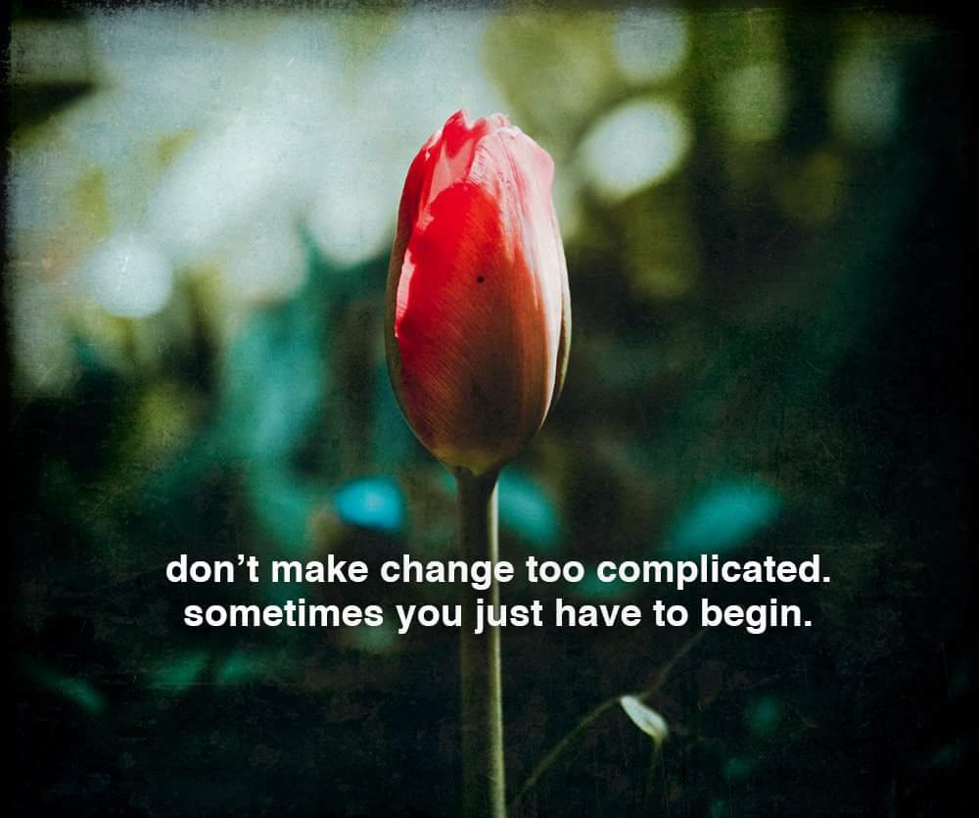

Slide 9
Start with…… WHY?
“The implementation of a restorative approach forces alignment of the system and processes in order to be congruent with what we say we do and what actually happens in practice. To work restoratively means that we value relationships and connectedness across the school community (organization).”
Overcoming Resistance to Whole-School Uptake of Restorative Approaches
Peta Blood and Margaret Thorsborne, 2006
The quality of learning / working / growth / well-being that takes place in our day depends on healthy relationships between and among all adults and students in our school community.
WHY? To development a healthy and positive school / work community.
Transform culture / Optimize conditions for teaching and working / Build collective efficacy

Slide 10
Then describe….. WHAT?
Over time, incorporate Restorative Practices at the governing board level, classroom, school, office and worksite that will lead to effective vertical and horizontal capacity building and overall sustainability in SSRSB.
Develop a network of staff within all areas of the organization that will support Restorative Practice as part of the fabric their daily lives.

Slide 11
Timeline 2017 / 2018
Elected Board exposure
Singular schools starting
2018 / 2019
2019 / 2020
2020 / 2021
???????????
….. Practice and Network …..
Build Capacity
& Monitor Progress
January
COMMUNICATE
Cohort 2 & 3
Jan. through April
GUIDING COALITION
&
CHECK INS
Cohort 1, 2 & 3
May 2018
Cohort 2
Cohort 3
Nov. / Dec. Cohort 1
BASIC TRAINING
{
All SSRSB divisions involved
“SELECTIVE”INVITATION
ACROSS
DIVISIONS
Dec. 13 Cohort 1
IMPLEMENTATION
BRAINSTORM
Jan. 16 & 17
Cohort 2
April
SUPPORTING LEARNING
Cohort 1, 2 & 3
{
All SSRSB divisions involved
Jan. 18 & 19
Cohort 3

Slide 12
Notes:
This was the next “move” …… start when you want, where you want and the support will be there.
Some challenges identified

Slide 13
CHALLENGE: It’s Another New Thing / Alignment
A WHOLE-PERSON APPROACH and CURRICULUM
Social and Emotional Learning – non-cognitive factors are as important as cognitive factors.
THE IMPORTANCE OF RELATIONSHIPS IN DEVELOPMENT AND LEARNING
The quality of the bond between people as a key to learning and healthy development.
A WHOLE-SYSTEM APPROACH
Creating a positive place to work and learn – sense of belonging, being connected, creating community, repairing harm.
POSITIVE INFLUENCE / DISCIPLINE
The circle structure generates and articulates shared values and translates them into behavioural norms.
A TRAUMA-SENSITIVE / SELF REGULATION / SOCIAL EMOTIONAL LEARNING / MINDFULNESS ENVIRONMENT
RA creates environment emotionally / physically safe, positive connections, recognized, heard, respected, valued.
CULTURAL COMPETENCY
RA creates the environment to reflect on self and others, assumptions, organizational practices and the context of our expectations and communication.
MINDFULNESS PRACTICE
RA practice encourages participants to slow down and be present with themselves and others.
Notes:
WHERE DOES RESTORATIVE PRACTICE FIT IN SSRSB?

Slide 14
CHALLENGE: Circle Understanding
“I decided to think outside the box and now I’m stuck inside this darn circle”
Be careful of rushing to the “circle” or only viewing RA through the circle.
Consider all system functions through the restorative lens?
How we induct new staff?
How we approach problems?
How we greet students as they enter the bus?
How we deal with performance appraisals?
Our status symbols?
Our system’s rituals?
Our office humour?
The stories we share?
The way we reward each other for great work?
What is our goal?
Who will be affected and how by the way in which we go about achieving that goal?

Slide 15
A restorative approach is about more than just repairing relationships when things go wrong.
It is also about making, remaking and maintaining
relationships.

Slide 16
Umbrella Concept
Restorative Approach =
A Relational Approach
Practices
Strategies
Policies/Procedures
Processes
What is our goal?
Who will be affected and how by the way in which we go about achieving that goal?
If we want to do things differently, we must also think differently about what we are doing.
Notes:
16

Slide 17
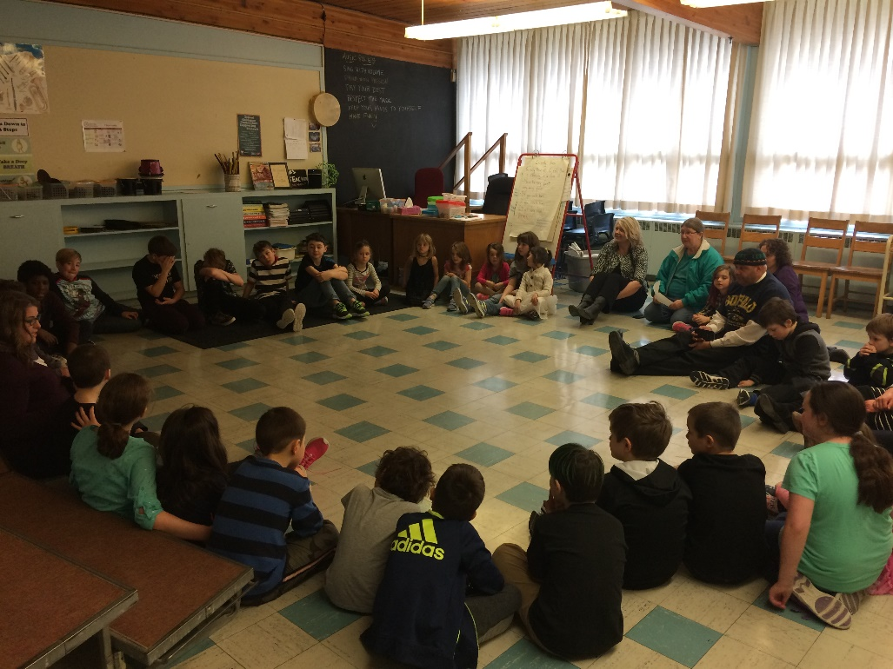
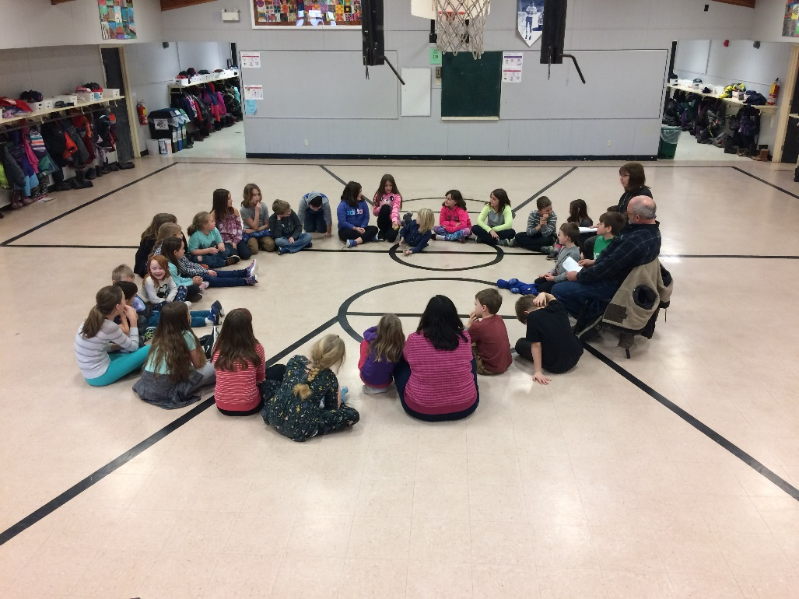
Elementary School and Transportation Staff

Slide 18
CHALLENGE: Our Environment and Budget
Developing System Relational Intelligence In Times of VUCA
Volatility
Increasing rate of change
Uncertainty
Less clarity about the future
Complexity
Multiple factors on a decision
Ambiguity
There might be no “right” decision
V
Vision
Purpose is greater than a perfect plan
Understanding
Stop, look and listen so that you can respond
Clarity
Make sense of chaos
Agility
Relational and collaborative approach to rapid change
U
C
A
Notes:
EI – our set of emotional and social skills that influence the way we perceive and express ourselves, develop and maintain relationships, cope with challenges, and use emotional information in an effective and meaningful ways
1996, 23 Boards to 8. 2018 8 Boards to 1 (CSAP).
Controversial school closure and reconfiguration decisions
Funding pressures in school boards
Leadership – Superintendent changes
Glaze Report
Inclusion Commission
Gov’t dissolved Boards
Administrators Association
Challenge: How to transfer power from traditional authority structure in a time of uncertainty

Slide 19
CHALLENGE: Transfer power for change from traditional structures in a time of uncertainty and budget pressure.
Structural Change
Cultural Change
Common set of beliefs
Shared vision for teaching and working
Growth mindset
High expectations for all
Participatory decision making
Cultural competency
Relational thinking
What we believe and think.
Our behaviours and actions.

Slide 20
Opportunity: Leap of Faith
It’s Like Building an Airplane in the Sky!!
It's Like Building an Airplane in the Sky!!
It's Like Building an Airplane in the Sky!!

Slide 21
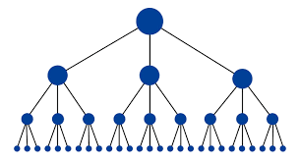
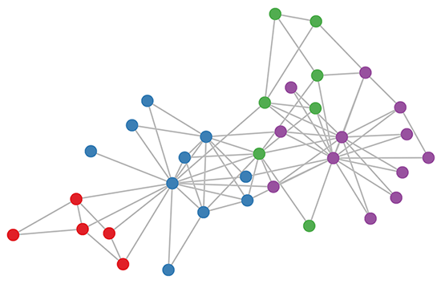
2011 / 2012
22 000 students
75 schools
Started at the school lead-team
4 Families of Schools
4 year implementation
Dedicated RA staff
2017 / 2018
6500 students
25 schools
Started across all divisions with volunteers
Early adopter lead guiding coalition
Start when ready, organic
Notes:
John Kotter

Slide 22
Hierarchy and Networks:
Change While the Airplane is Being Built
Notes:
Once the networks becomes too large, it has to organize itself – operations, finance, human resources

Slide 24
Hierarchical change management is an EVENT

Slide 25
Dual Operating Systems
Management Hierarchy
Strategy Network
Not
EITHER / OR rather
BOTH / AND

Slide 26
“… existing structures and processes that together form an organization’s operating system need an additional element to address the challenges produced by mounting complexity and rapid change. The solution is a second operating system, devoted to the design and implementation of strategy, that uses agile, network-like structures and a very different set of processes.”
John Kotter (HBR 2012)

Slide 27
Dual Operating Systems
Management Hierarchy
Strategy Network
CHARACTERISTICS:
Reliable, efficient, predictable
Same people lead initiatives
Communication silos
Information flow slow up and down
Chances not taken without permission
Past success can build complacency and change resistance, status quo, comfort, power
Change management works best in a stable environment, with money
ACTION THROUGH:
Planning and policy
Budgeting
Committee and sub-committee
Reward and punishment
CHARACTERISTICS:
Messy and uncertainty
Agility, speed and responsive
Constant innovation and trial
Safe to make mistakes and learn
Membership changes
Mobilizes / develops shared, leveled-leadership
Identifies barriers quicker
Strata of staff involved
Grass-roots changes that changes culture
Can weather change in uncertainty better
ACTION THROUGH:
Urgency of early adopters
Guiding Coalition facilitates communication, sharing ideas, and is the “pulse”
Clarifying vision
Attract adopters to network
Celebrate success
Relentlessness and organic

Slide 28
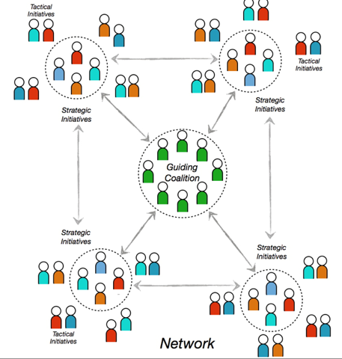
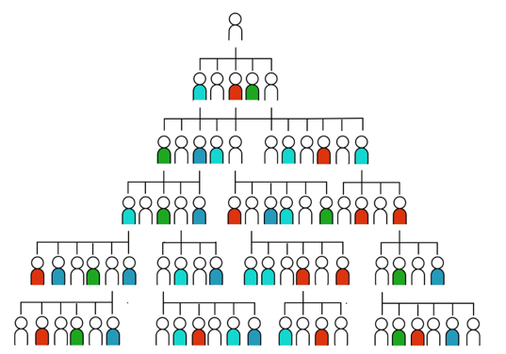
Management Driven
HIERARCHY
Strategy
NETWORK
HOW?
Ready? Participate
Notes:
Many on-ramps … tapping into something already occurring in the office, classroom, interaction, being able to try, fail, try, fail, share, growth mindset,
Early adopter allowing themselves to express vulnerability.
Denise Crouse, built relationships by seeking input in bus rules
Creating a shared vision, creating a burning platform
Effective implementation strategies across the system
Staying persistent
Alignment with other initiatives
Identifying and dealing with potential barriers
Celebrating positive benefits
PES, bus drivers, student self-regulation
Explicit teaching / growth
mindset / common language

Slide 29
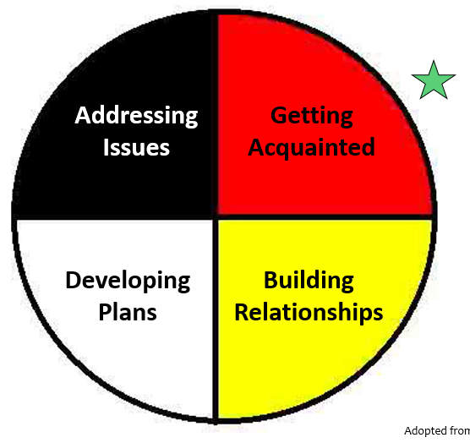
Adopting a Restorative Approach at Your School / Worksite
Establish a team / talk about this work / start yourself / make a plan / just do it!!
Staff introduction …. Start with Why?
Introduction to associated groups: School Advisory Councils, Union, parents, partners
Growth in practice, a journey / a way of being / take risks and learn

Slide 30
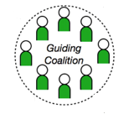
Call went out to the three training cohorts
Twelve early adopters arrived – teachers, Principals, psychologists, Human Resources, instructional coaches
Shared successes and challenges
Developed plans moving forward
Meet again soon
Need to develop a shared vision
Google Drive to share information
Continue training in October 2018
Continue to share experiences and attract others
Explore Restorative Approach and curriculum delivery
Mesh Restorative Practice with Cultural Competency
Continue mindset of leading from around rather than adopting from above
Publically celebrate successes
Identify model classrooms / schools / worksites

Slide 31
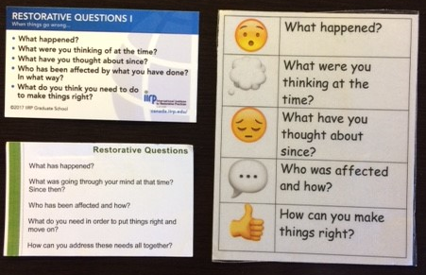
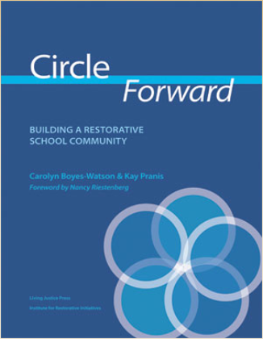

Slide 32
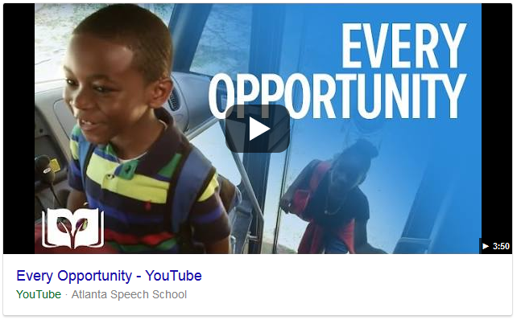
Every Opportunity

Slide 33
Thank you
English
Merci
French
Wela’lioq
Mi’kmaq
Danke
German
Asante
Swahili
Scott Milner
smilner@ssrsb.ca

