Slide 1
IIRP Conference – Learning for the 21st Century
Workshop Session
Teaching Youth Restorative Practices
Through Lessons On
Accountability, Compassion, And Forgiveness

Slide 2
WORKSHOP AGENDA
Welcomes and Introductions
Teaching Restorative Practices In Schools
Restorative Life Skills
TKF Curriculum
Incorporating Forgiveness
Practicing Restorative Techniques
2

Slide 3
WORKSHOP LEARNING OBJECTIVES:
Participants will learn about a successful model for adolescent education that teaches peace and forgiveness through instruction in restorative practice
Participants will review a middle level curriculum that teaches restorative principles.
Participants will take part in instructional activities and a closing circle to demonstrate the program’s impacts in providing youth and instructors with healing strategies that build self-esteem, advocate peacemaking, and promote healthy life skills.

Slide 4
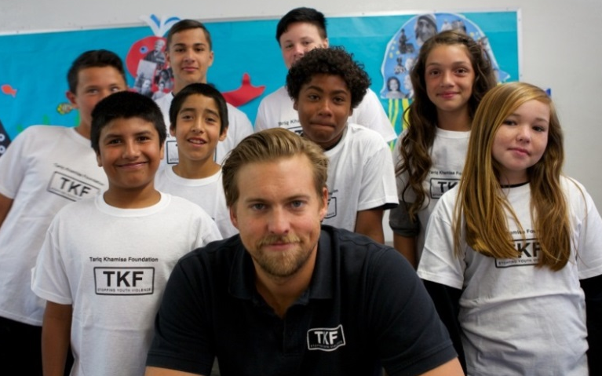
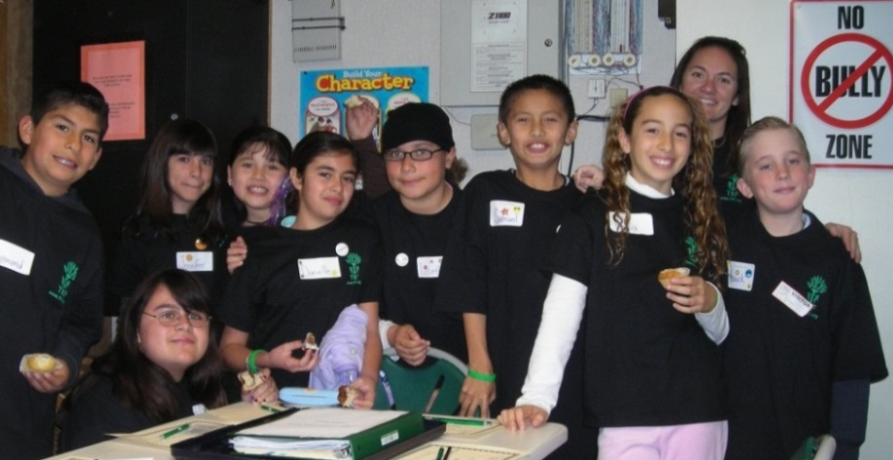
Tariq Khamisa Foundation (TKF)
San Diego, CA non-profit
Founded in 1995 after a family’s tragedy due to gang violence
Over twenty years experience in prevention programs
Partnered with more than 300 local schools
TKF direct services have connected with over 550,000 children

Slide 5
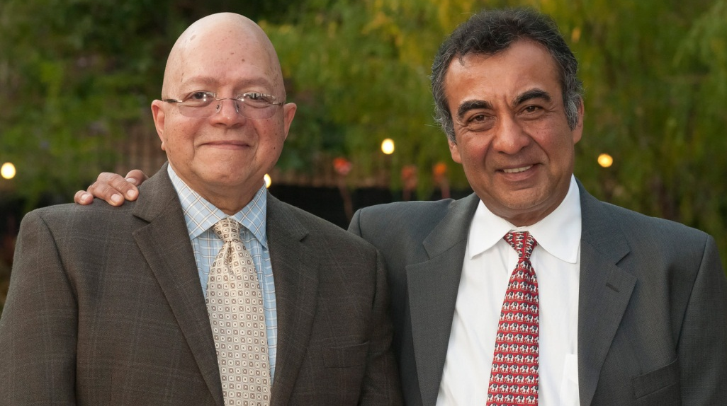
The TKF Story
Ples Felix & Azim Khamisa
“This man’s grandson killed this man’s son.”
TKF VIDEO

Slide 6
TKF SIX KEY MESSAGES
Violence is real and hurts everyone
Your actions have consequences
You can make good and nonviolent choices
You can work toward forgiveness as opposed to seeking revenge
Everyone deserves to be loved and treated well
From conflict, love and unity are possible
All TKF services are built on restorative practices principles

Slide 7
TKF SAFE SCHOOL MODEL
SCHOOL/COMMUNITY ENGAGEMENT SERVICES
INDIVIDUAL
SERVICES
EDUCATIONAL SERVICES
Mentoring
Alternative Suspension Services
Restorative Curriculum
Peacemaker Assemblies
Peace Clubs
Coordinated Campus Presence
Service Projects
Local Resource Referrals
Teacher Trainings
Parent Workshops
School Events

Slide 8
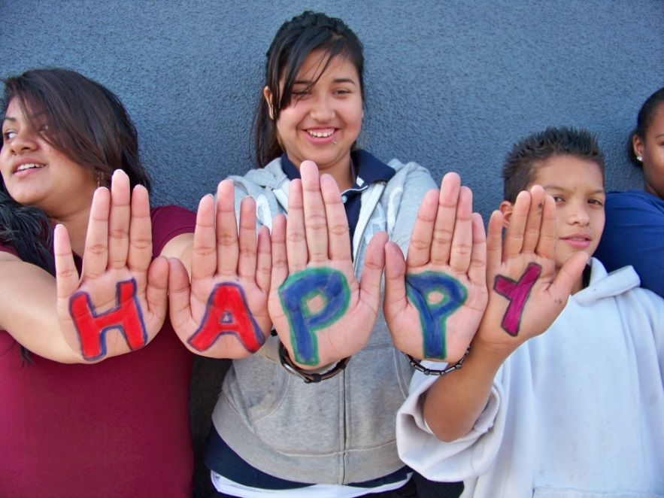
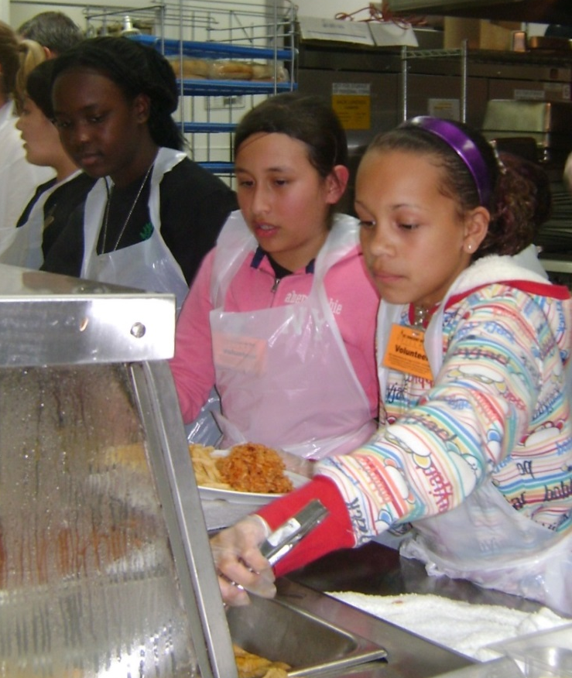
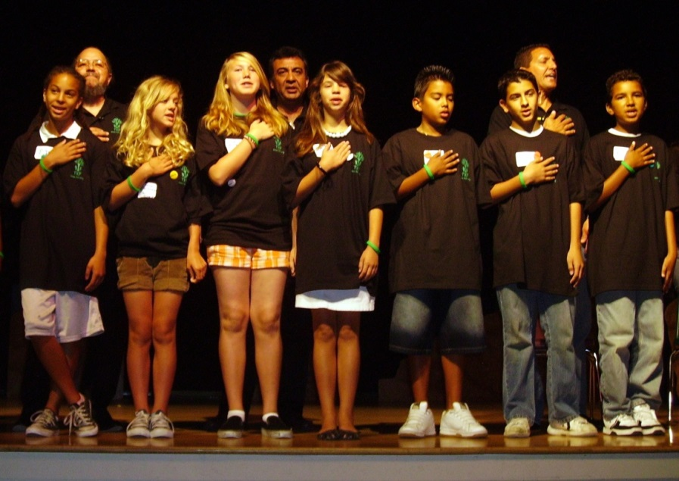
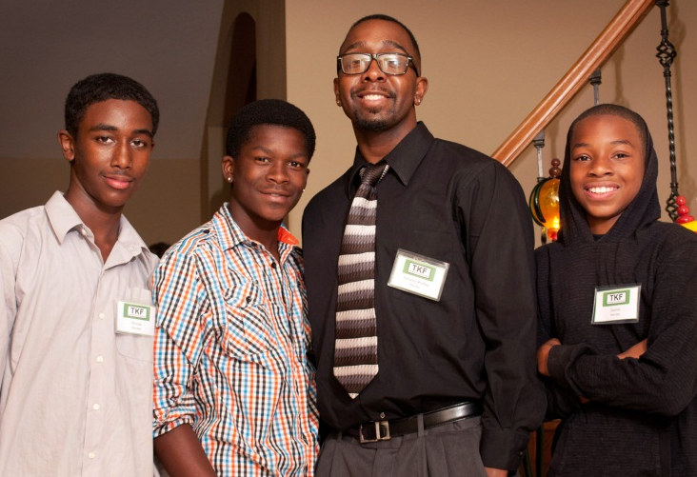
Service
Opportunities
Needed Support & Caring
Fun & Interactive Learning
Peace Commitment

Slide 9
EARLY PARENTAL RP INSTRUCTION
Play nice and don’t hit!
Be fair and
get along with others!
Say sorry!

Slide 10
RP CONTINUUM
©International Institute for Restorative Practices
Informal Formal
Affective Statement – Statements or comments about how others are impacted by one’s behavior
Affective Questions - Questions that ask one to think about how their actions affected others
Restorative Dialogue – Conversation to clarify responsibility and perspectives regarding an incident
Community Circle – Structured group dialogue to share information, discuss an issue or incident, and to offer solutions for what happened
Restorative Conference – Structured face-to-face dialogue with responsible and impacted parties to discuss specific incident and harm and find ways to possibly make things right and repair relationships
Affective Statements | Affective Questions | Restorative Dialogue | Community Circles | Restorative Conferences

Slide 11
RP IN SCHOOLS
Designed to support the educational mission of schools to help children learn and grow. RP is about taking advantage of teachable moments to learn life lessons.
A proactive, preventative approach that teaches social-emotional skills and examines the root causes of negative behaviors.
Foster deeper learning and deeper relationships.
Emphasis on communication and listening skills to meet instructional educational standards
Be willing to create safe and trusting environment where students can and want to dialogue, share, and feel supported
Approach RP as a way of life focused on problem resolution, peace education, communication, and healing

Slide 12
RESTORATION FOUNDATION of principles, values, and strategies that can be applied in their daily lives
Blends Social-Emotional Learning
and Life Experiences
Understand and manage emotions and behaviors
Think thru and process life situations
Have a voice in improving harmful situations and reducing their impacts
Build community thru relationships and healing
Teach and encourage use of restorative principles as a life skill
12

Slide 13
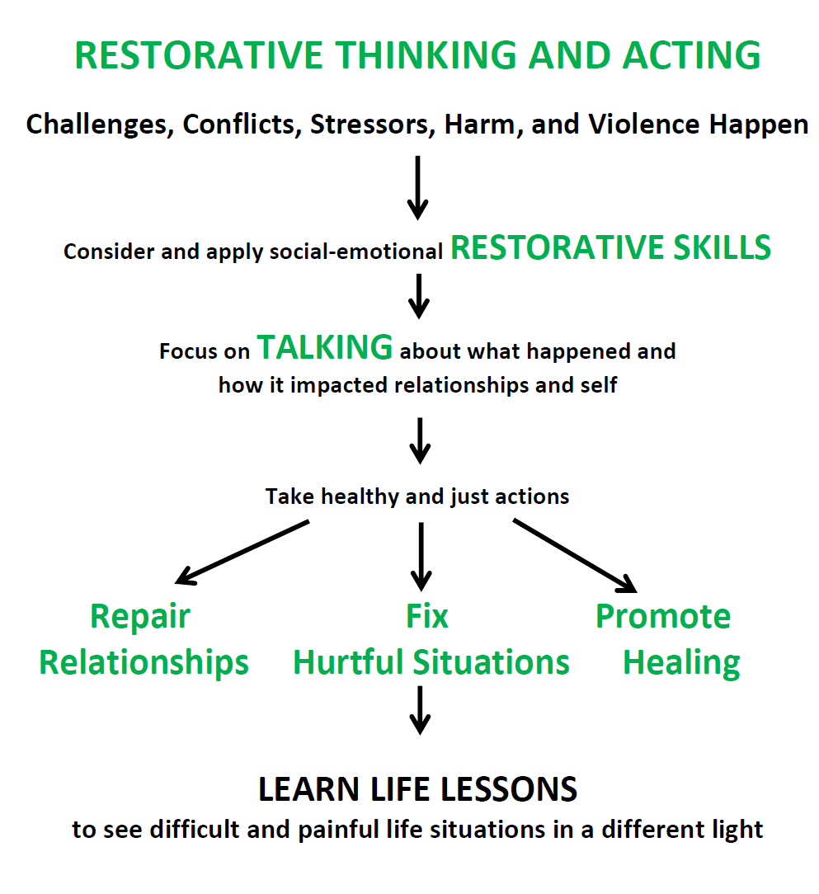

Slide 14
IT MATTERS TO KIDS
HOW THEY ARE TREATED
Restorative Practices is a method focused on responsibility, respect, and inclusion
Be aware of the impacts of their actions and behaviors
Understand their obligation to take responsibility for their actions
Teaches one to value others and manage their relationships
Process to take actions to right wrongs and change behaviors
Restorative Intentions

Slide 15
SOCIAL-EMOTIONAL RESTORATIVE SKILLS
Safety
Environment that feels protective, understanding, compassionate
Good Communication Skills
Open to talk about difficult situations, their voice is heard and valued, problem solving techniques, listen to others
Mindfulness
Calming techniques, focused, alert, and present
Critical Thinking Skills
Considering options and consequences, learning from mistakes,
using their resources/supports, making good choices

Slide 16
SOCIAL-EMOTIONAL RESTORATIVE SKILLS
Emotional Management
Understand and manage needs, feelings, and reactions
Self-Confidence
See self in a positive light, open to learning, setting and meeting goals, resilient
Positive Relationships
Have personal boundaries, cooperative with others, caring peers, trustworthy adults
Making Amends
Apologizing, taking actions to make things right, forgiveness
Practice Civility
Peacemakers, leadership opportunities, socially responsible, equality, community

Slide 17
RP INSTRUCTIONAL CONSIDERATIONS
RP work can be emotional and personal. It can bring up difficult and painful memories for you and students. As a facilitator you need to be in a strong, capable, and compassionate place when processing with students.
Difficult for students because it involves talking about their hurts, pains, mistakes and sadness. Helping students not be stuck in wrongful or negative actions, thoughts, or situations.
Conducting in an environment that feels safe and understanding
Acknowledge students’ participation
Inform and train parents in RP

Slide 18
TKF RESTORATIVE CURRICULUM
A three-tiered educational program for grades 5 to 9 that instructs students in restorative principles and their application
It is a ten-session workshop focused in social-emotional development to assist students with mindful decision-making, regulating emotions, and becoming peacemakers
Students learn and practice skills to address harm and challenges, understand consequences and the impacts of their actions, and build positive relationships with self, peers, and adults
Encourages students to become engaged and informed peacemakers and promotes good citizenship

Slide 19
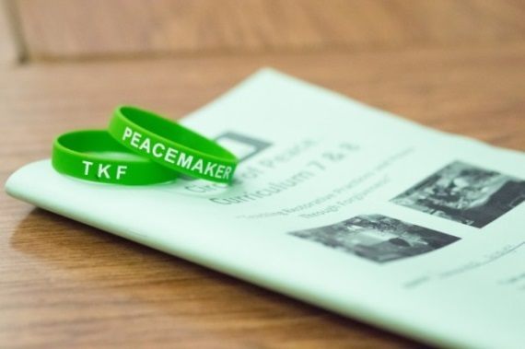
TKF RESTORATIVE CURRICULUM
Instruction is from the perspective of the Restorative Practice Questions
What happened?
What were the thoughts and feelings at the time of the incident?
Who was affected by what happened?
What were the impacts of what happened?
What needs to happen to make things right?
Emphasis on personal skill development
Self Esteem
Compassion and Cooperation
Relationships
Forgiveness
Civic Engagement and Social Responsibility

Slide 20
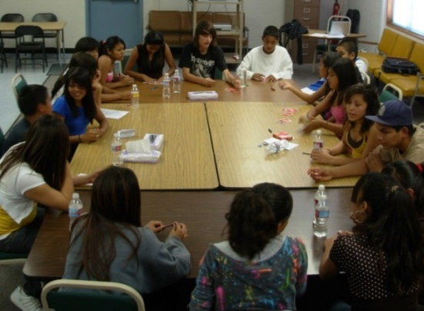
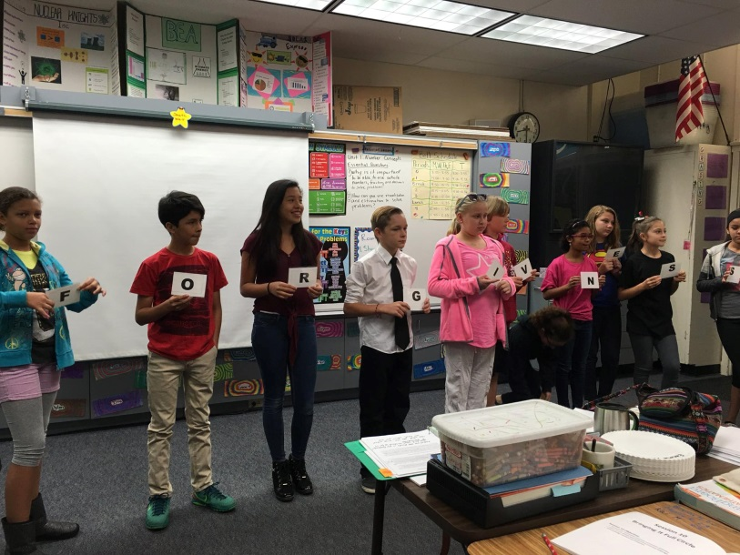
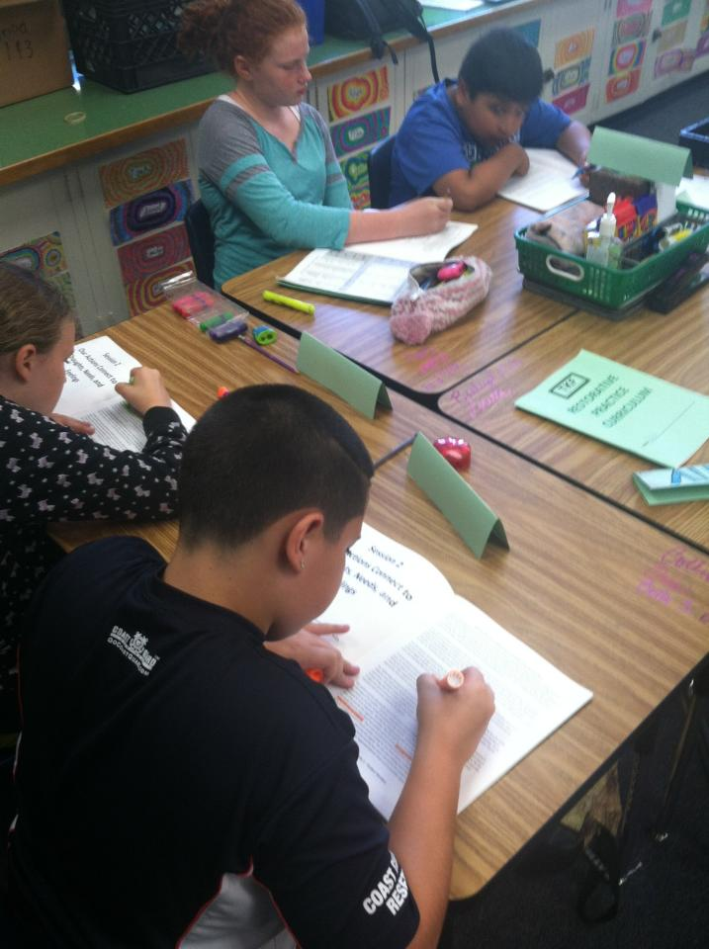
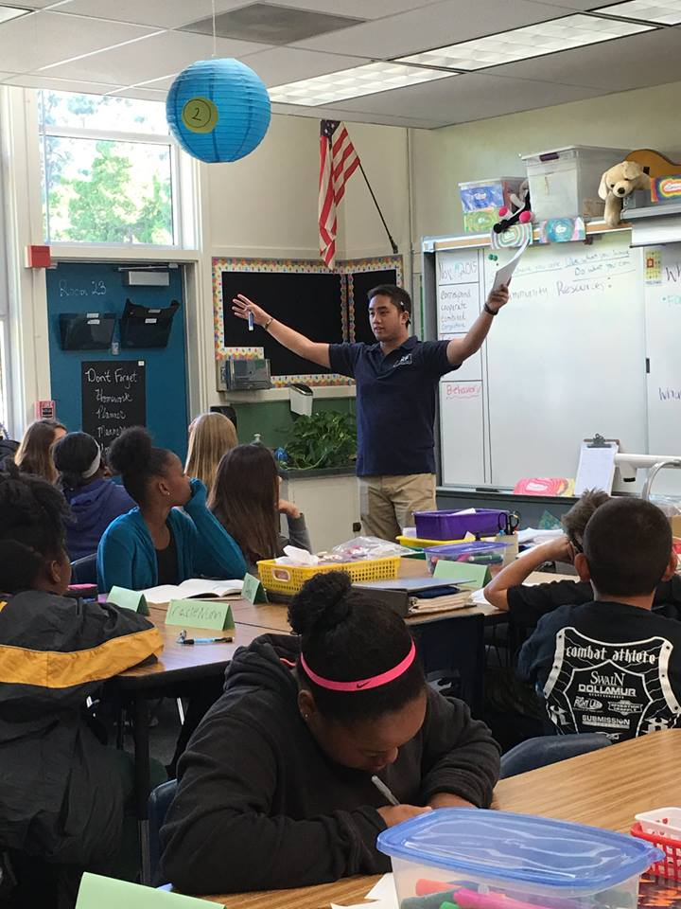
TKF RP CURRICULUM

Slide 21
TKF CURRICULUM EXERCISE
CONNECTING NEEDS, FEELINGS, & ACTIONS
21

Slide 22
TKF CURRICULUM RESULTS
Since 2015, the TKF Restorative Curriculum has been facilitated with over 4,000 middle school students
86% of students reported that the curriculum taught them how to take actions to prevent or resolve problems.
82% of students learned to be positive about myself.
79% of students reported that the curriculum taught them how to be mindful.
76% of students learned how to be peacemakers.
*Based on a 2016 study by the San Diego State University
Social Science Research Lab

Slide 23
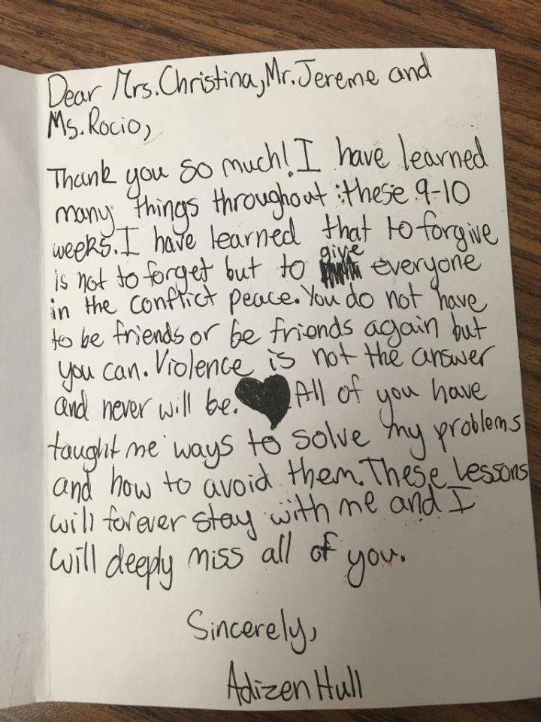
TKF CURRICULUM RESULTS
STUDENT COMMENTS
The most helpful thing I learned is how to be more accepting to others and their opinions.
When I am mad with someone at home or school I now know how to calm down and think about what I’m going to say.
These classes taught me how to be a better person.
TEACHER AND PARENT COMMENTS
I see a difference in how our students are interacting with one another on campus. There is a more respectful climate happening.
My daughter comes home excited about what she is learning in the TKF classes. She is even showing the rest of the family how to talk to each other in a better way.

Slide 24
TKF CURRICULUM NEXT STEPS
Launch third-party impact evaluation of the TKF Restorative Curriculum with a goal of study publication
Develop trainer-of-trainers module to create opportunities to expand the TKF Restorative Curriculum’s availability
Identify school partnerships outside of California

Slide 25
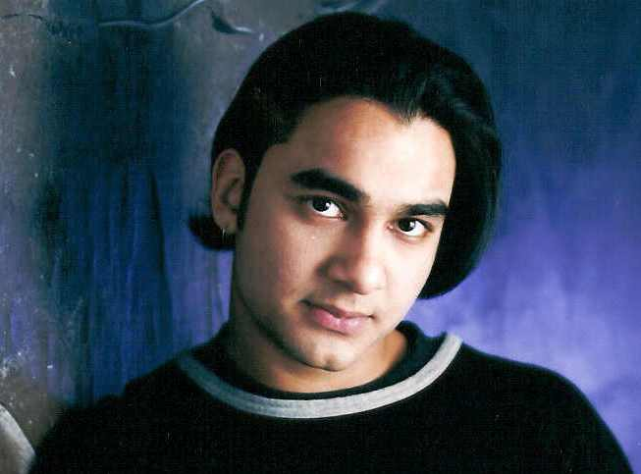
INCORPORATING FORGIVENESS
Forgiveness is a personal journey rooted in restorative actions.
Forgiveness does not change the past,
but it does change the future.

Slide 26
UNDERSTANDING FORGIVENESS
Forgiveness is the intentional and voluntary process by which someone undergoes a change in feelings and attitude regarding something wrong, harmful, or negative that has happened to them or that they caused.
Forgiveness Is Essential To Healing
Forgiveness is about being able to
LET GO
Giving up the negative emotions and reactions that result from harmful events or actions

Slide 27
UNDERSTANDING FORGIVENESS
Happens in stages over time
Removes emotional obstacles
Opens one up to change and healing
Allows one to gain empathy and tolerance for others
Contributes to our happiness and peace of mind
THE MYTHS OF FORGIVENESS
Not a sign of weakness
It does not mean that you have to forget
Does not remove consequences
Don’t have to act as if something did not happen or excuse it
You do not have to confront the other person in order to forgive

Slide 28
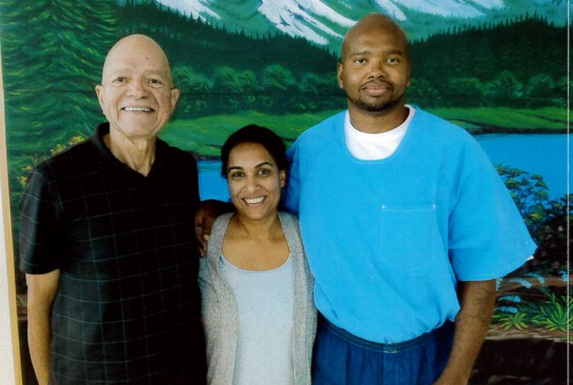
UNDERSTANDING FORGIVENESS
FOSTERS HOPE
Encourage and acknowledge goals, achievements, and success
Support actions that make things happen and creates positive changes
Find satisfaction in one’s life
Create pathways and plans for a brighter future
Tony Hicks

Slide 29
To learn more visit us at www.tkf.org
Tasreen Khamisa, Executive Director
tasreen@tkf.org
619-955-8777 ext. 101
Benita Page, Program Director bpage@tkf.org
619-565-3214
Follow TKF
29

